Slide 1

Introduction
Course Title : | ARTIFICIAL INTELLIGENCE AND MACHINE LEARNING
Course Code : | 24AD2001
L-T-P-S Structure : | 3-0-2-0
Credits : | 4
Course Coordinator : | Dr. MANIKYA PRASUNA PAKALAPATI

Slide 2
ARTIFICIAL INTELLIGENCE & MACHINE LEARNING
syllabus
CO1: Brief History & Paradigms: Symbolic AI, sub symbolic AI, machine learning, the rise of data-driven AI. Intelligent Agents: Rational agents, agent environments, PEAS framework. Problem Formulation: States, transitions, costs, search spaces, applications Classical Search: Uninformed (BFS, DFS, UCS, IDS);Informed (Greedy, A*); Admissible/consistent heuristics; Heuristic Search: Hill climbing, variants of hill climbing Constraint Satisfaction: CSPs, arc consistency, forward checking, backtracking, variable ordering.Game Playing: Minimax, alpha-beta pruning. AI Applications: Search in robotics, logistics, games, expert systems.
CO2: Mathematical & Statistical Foundations for ML : Linear Algebra: Vectors, matrices, matrix operations, Eigen decomposition, SVD. Calculus & Optimization: Derivatives, gradient descent, convexity, Taylor expansion, optimization objectives. Probability & Statistics: Distributions, expectation, variance, covariance, Bayes’ theorem. Data Handling: Noise reduction methods (FFT, etc.), Outlier detection (box plot ,etc..), imputation (using (KNN, Measures of centrality, etc..), scaling(standardization , normalization ,etc..),encoding (one hot vector encoding, image and text embeddings), variable types (ordinal ,categorical) . Feature Engineering: elimination, aggregation, feature selection methods (mutual information, information gain, Fisher score, etc.). Model Selection: Under fitting and Over fitting, Bias-variance trade off, cross-validation, train/val/test splits, learning/validation curves.
CO3: Supervised Machine Learning Algorithms: Linear Models: Linear regression, logistic regression, regularization (ridge, lasso). Basic Models: Curse of Dimensionality, KNN, Decision Tree (training & Pruning algorithms) Support Vector Machines: Max-margin principle, soft margin, kernel trick (RBF, polynomial, sigmoid), hyper plane geometry. Ensemble Methods: Bagging, random forests, AdaBoost, stacking. Probabilistic Models: Gaussian Naive Bayes, Gaussian Processes (regression/classification), calibration and confidence. Evaluation: ROC, AUC, confusion matrix, F1, recall/precision, model explain ability.
CO 4: Unsupervised & Advanced ML + ML Automation Clustering: K-means, C-means, Fuzzy C-Means, GMM, hierarchical, DBSCAN, mean-shift, cluster validity metrics. Dimensionality Reduction: PCA, LDA, t-SNE, UMAP, manifold learning. Anomaly Detection: Isolation forests, LOF, one-class SVM, auto encoders (as preview). Automated ML: Pipeline automation (sklearn, PyCaret), experiment tracking (MLflow). Ethics, Fairness, Explainability: Bias sources, mitigation, transparency, human-in-the-loop.

Slide 3
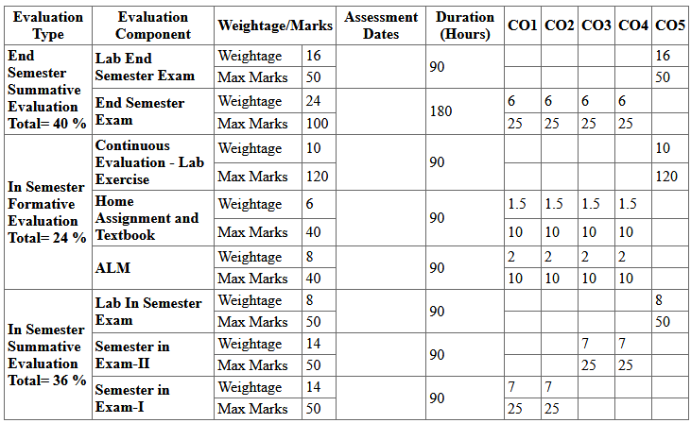
Evaluation components

Slide 4
Introduction to AI
Artificial Intelligence is composed of two words Artificial and Intelligence, where Artificial defines “Man-Made," and Intelligence defines “Thinking Power", hence AI means “A man-made thinking power."

Slide 5
AI - Definition
Artificial Intelligence (AI) refers to the simulation of human Intelligence in machines that are programmed to think and learn.
"It is a branch of computer science by which we can create intelligent machines which can behave like a human, think like human and able to make decisions."

Slide 6
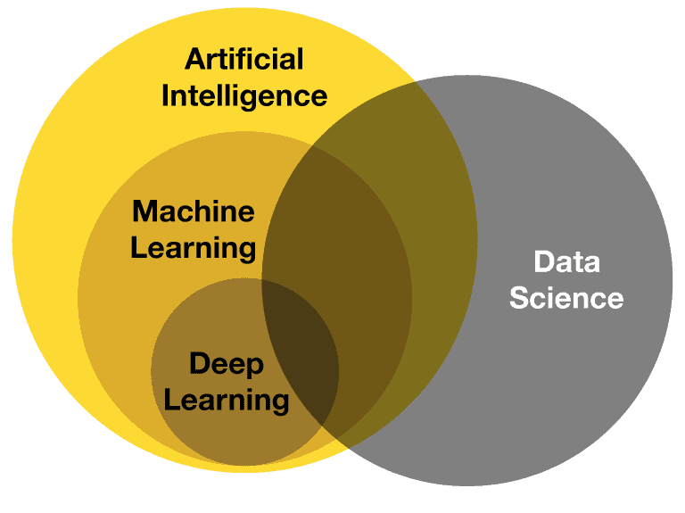
ML - Definition
Machine Learning (ML) is a Subset of Artificial intelligence (AI) that enables systems to learn from data and improve their performance on a specific task over time, without being explicitly programmed.
ML algorithms identify patterns and make predictions or decisions based on the data they've been trained on.

Slide 7
HISTORY OF AI
The Birth of AI (1950s): Alan Turing
  Introduced the Turing Test and Proposed the idea of a "Computing Machinery and Intelligence“
1956: Dartmouth Conference
John McCarthy Who coined the term in 1956, defines it as “The Science and Engineering of making intelligent machines, especially intelligent computer programs.”

Slide 8
HISTORY OF AI
The Golden Years (1960-1970)
Optimism and Progress:
  ELIZA (1966): Created by Joseph Weizenbaum, a natural language processing computer program that simulated conversation.
  Shakey the Robot (1966-1972): First general-purpose mobile robot able to reason about its actions.
Early AI Applications: Development of systems for medical diagnosis, symbolic mathematics, and chess playing.

Slide 9
HISTORY OF AI
The Rise of Modern AI (2000s-Present)
Machine Learning: Rise of new algorithms and techniques for data-driven learning.
Big Data & Improved Algorithms: Enhanced computational power and access to large datasets.
Key Innovations:
  Deep Learning: Use of deep neural networks for image and speech recognition.
  AI in Everyday Life: Virtual assistants (Siri, Alexa), autonomous vehicles, recommendation systems.
Milestones:
  IBM Watson (2011): Won Jeopardy! against human champions.
  AlphaGo (2016): Developed by DeepMind, defeated the world champion Go player

Slide 10
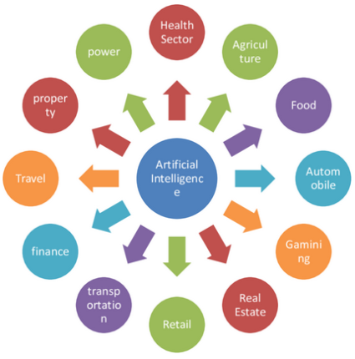
Applications of AI
1. Game Plying
2. Medical Diagnosis, Autonomous Control
3. Autonomous Planning and Scheduling
4. Expert Systems
5. Robotics
6. Natural Language Processing
7. Computer Vision
8. e- Commerce
9. Agriculture
10. Finance

Slide 11
Applications of AI in Healthcare
Diagnostics:
  Medical Imaging: AI algorithms analyze X-rays, MRIs, and CT scans to detect diseases like cancer, fractures, and infections.
  Pathology: AI systems assist in examining tissue samples for accurate diagnosis.
Personalized Medicine: AI analyzes patient data to tailor treatments to individual genetic profiles and health histories.
Robotic Surgery: Robots like da Vinci Surgical System enhance precision in complex surgeries, reducing recovery times and improving outcomes.
Drug Discovery: AI accelerates the process of discovering new drugs by predicting molecular interactions and potential side effects.

Slide 12
Applications of AI in Smart Homes and Cities
Home Automation: AI controls home devices such as lights, thermostats, and security systems for convenience and energy efficiency.
Smart Grids: AI optimizes energy distribution and usage in power grids, enhancing sustainability.
Urban Planning: AI analyzes data on traffic, pollution, and population to improve city planning and infrastructure.

Slide 13
Applications of AI in Education
Personalized Learning: AI systems adapt educational content to the learning pace and style of individual students.
Tutoring Systems: AI-powered tutors provide additional support and resources to students outside of the classroom.
Administrative Tasks: AI automates grading, scheduling, and other administrative tasks, freeing up time for educators.

Slide 14
Applications of AI in Transportation
Autonomous Vehicles: AI powers self-driving cars by processing data from sensors and cameras to navigate safely.
Traffic Management: AI systems analyze traffic patterns to optimize signal timings and reduce congestion.
Logistics and Supply Chain: AI optimizes routes for delivery trucks, manages inventory levels, and predicts demand.

Slide 15
Applications of AI in Agriculture
Precision Farming: AI analyzes data from soil sensors, weather forecasts, and crop health to optimize farming practices.
Crop Monitoring: Drones equipped with AI analyze aerial images to detect diseases and pests in crops.
Yield Prediction: AI models predict crop yields, helping farmers make informed decisions about planting and harvesting.

Slide 16
Applications of AI in Finance
Fraud Detection: AI systems monitor transactions in real-time to identify suspicious activities and prevent fraud.
Algorithmic Trading: AI algorithms analyze market data and execute trades at high speeds, optimizing investment strategies.
Risk Management: AI assesses credit scores and loan eligibility, helping financial institutions manage risks.
Customer Service: Chatbots and virtual assistants handle customer inquiries, providing efficient and accurate responses.

Slide 17
Self Assessment Questions
AI Technology makes the machines to ……………………
Act like Human…
Think like Human…
Speak like Human…
All the above …
AI is a rapidly evolving field with vast potential to transform numerous aspects of society
True
False

Slide 18
Reference books and web links
Text Books:
Russel and Norvig, ‘Artificial Intelligence’, third edition, Pearson Education, PHI, (2015)
Elaine Rich & Kevin Knight, ‘Artificial Intelligence’, 3nd Edition, Tata McGraw Hill Edition, Reprint (2008)
Web links:
https://www.geeksforgeeks.org/agents-artificial-intelligence/
https://www.simplilearn.com/what-is-intelligent-agent-in-ai-types-function-article
https://www.javatpoint.com/turing-test-in-ai
https://www.geeksforgeeks.org/turing-test-artificial-intelligence/
https://www.section.io/engineering-education/turing-test-in-ai/

